Slide 1

Robot Navigation by Reinforcement Learning
Final project 1 by Team 10
EEE 598, Fall 2024
Kannak Sharma, Lili Ye, and Zeming Zhou
School of Electrical, Computer, and Energy Engineering,
Arizona State University
Contacts: [ksharm88, liliye, zzhou157]@asu.edu

Slide 2
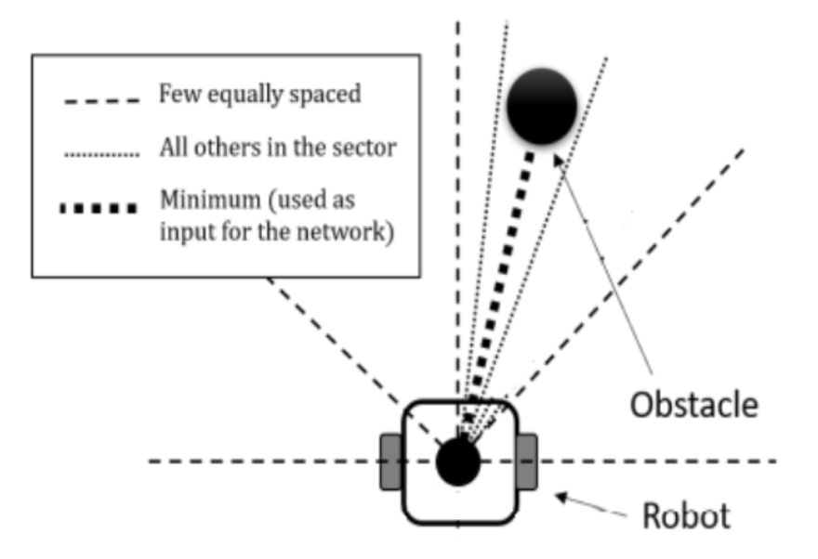
What is the issue/prompt under discussion
Objective
Develop adaptable, collision-free navigation for robots in unstructured settings using RL and PPO algorithms.
Key Challenges
Obstacle Avoidance: Navigate around static (e.g., walls) and dynamic obstacles (e.g., people, other robots).
Real-Time Decision Making: Rapidly process continuous data for immediate response.
Limited Sensory Data: Operate with incomplete view of surroundings using local sensors (e.g., LiDAR).
Adaptability: Generalize navigation strategies across various environments without reprogramming.
Our Approach
Proximal Policy Optimization (PPO): Reliable for continuous action spaces, ideal for dynamic navigation.
Actor-Critic Model: Enhances decision-making by evaluating actions for a balanced, adaptive response.
LiDAR Integration: Enables real-time adjustments without reliance on pre-defined maps.
current practice
Fig. LiDAR-based obstacle detection: minimum distance in sector used as input for PPO network

Slide 3
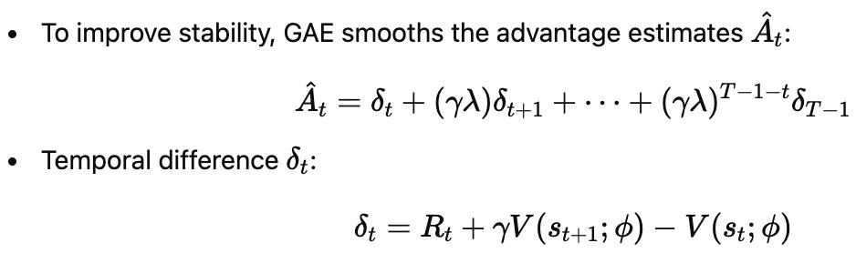
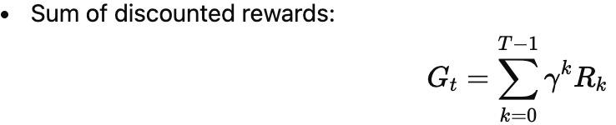
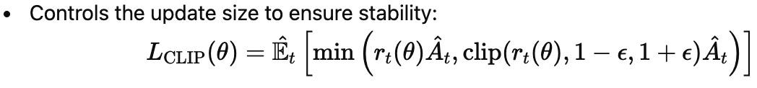

PPO Algorithm - Key Components and Formulas
Generalized Advantage Estimation (GAE)
2. Return Calculation
3. Clipped Surrogate Objective
4. Value Function Loss
3

Slide 4
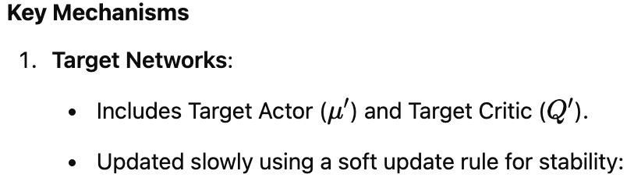
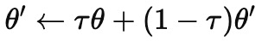
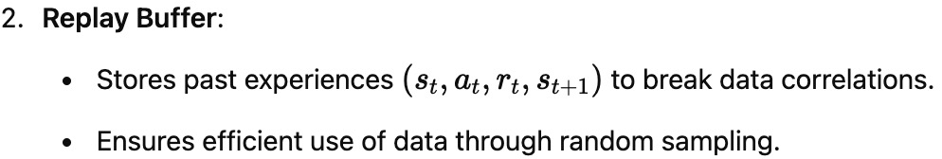
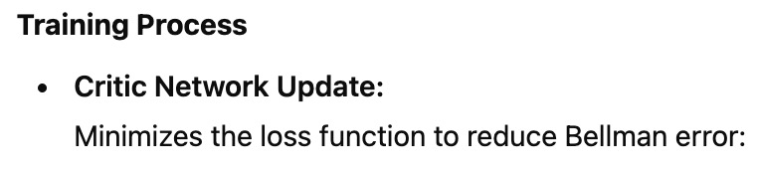
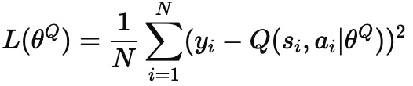
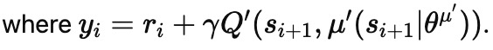
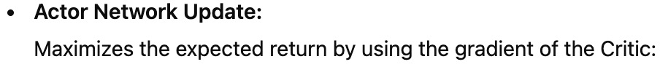
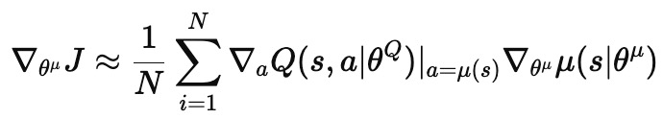
Deep Deterministic Policy Gradient (DDPG)

Slide 5
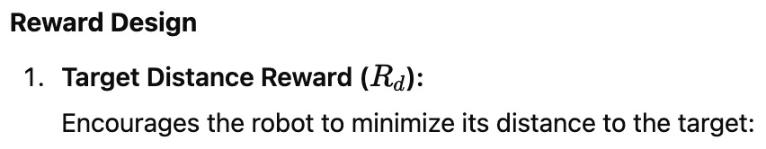
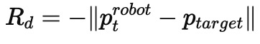
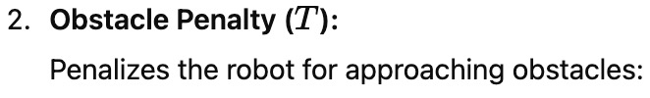
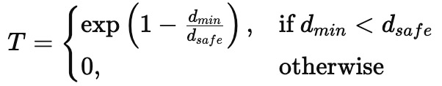
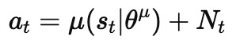
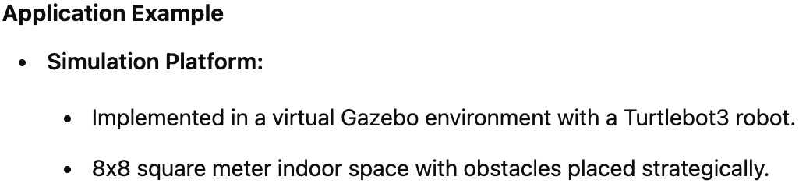
DDPG in Robot Navigation

Slide 6
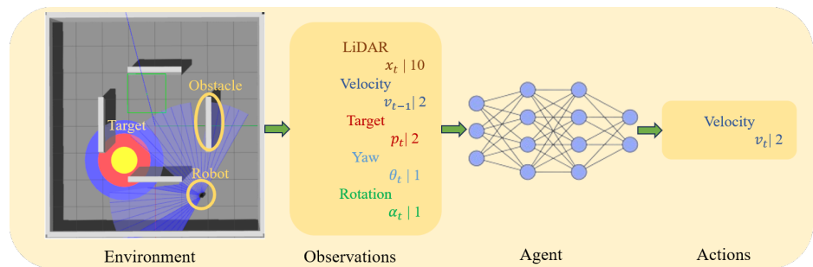
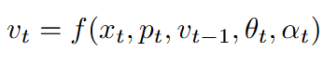
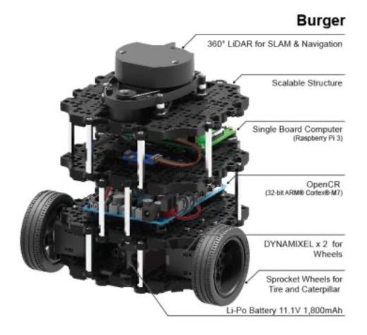
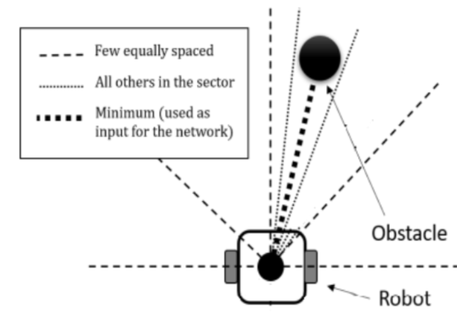
Problem Setup

Slide 7
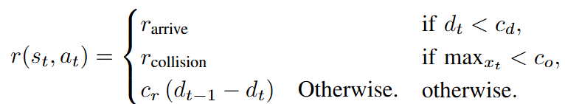

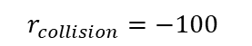
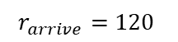
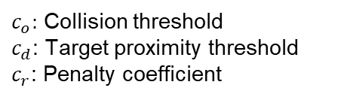
Problem Setup
$$r_{arrive}=120$$
$c_{o}:$ Collision threshold
$c_{d}$: Target proximity threshold
$c_{r}$: Penalty coefficient
$$r_{collision}=−100$$
$$c_{r}=500$$
Training details:
Episodic training: When collision or max time step = 800 or arrive the target
Batch size = 8000 time steps
Epochs = 100 steps with Adam optimizer for gradient descent

Slide 8
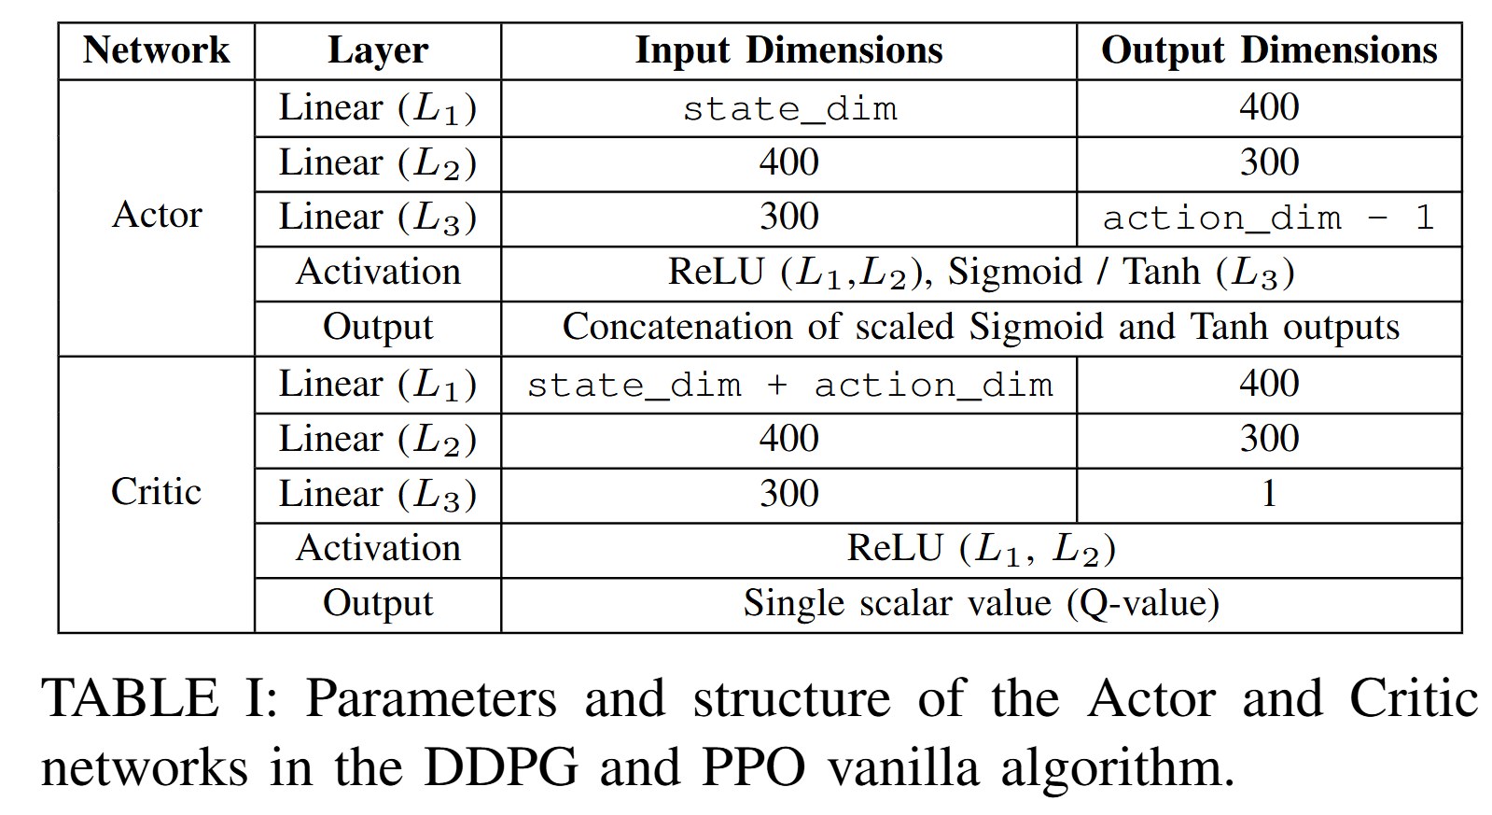

Model architecture

Slide 9
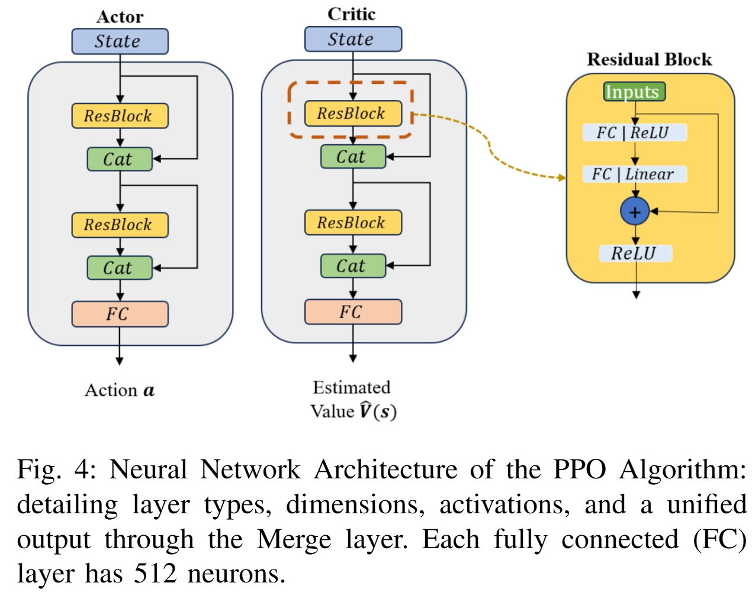
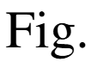
Model architecture

Slide 10
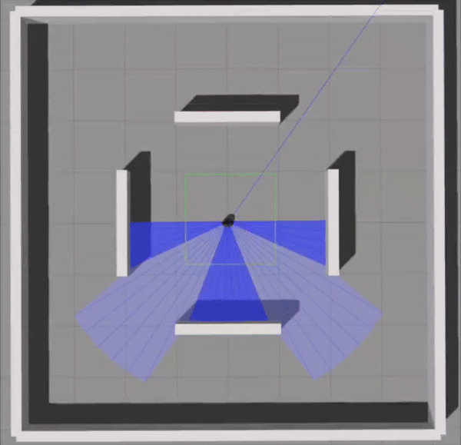
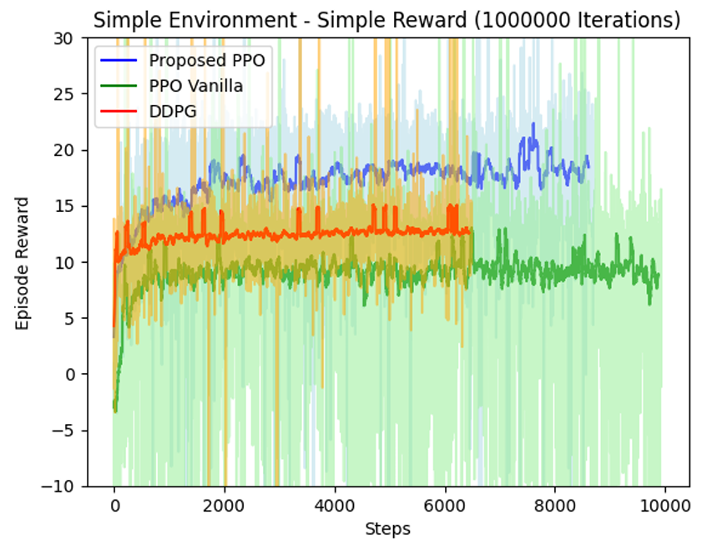
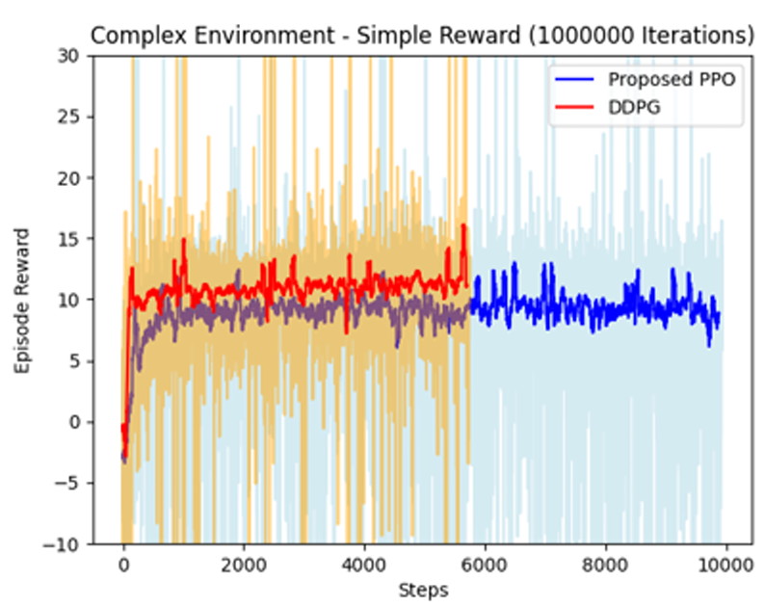
Performance
H. Taheri and S. R. Hosseini, “Deep re-inforcement learning with enhanced PPO forsafe mobile robot navigation,” arXiv preprintarXiv:2405.16266, 2024

Slide 11
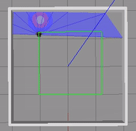
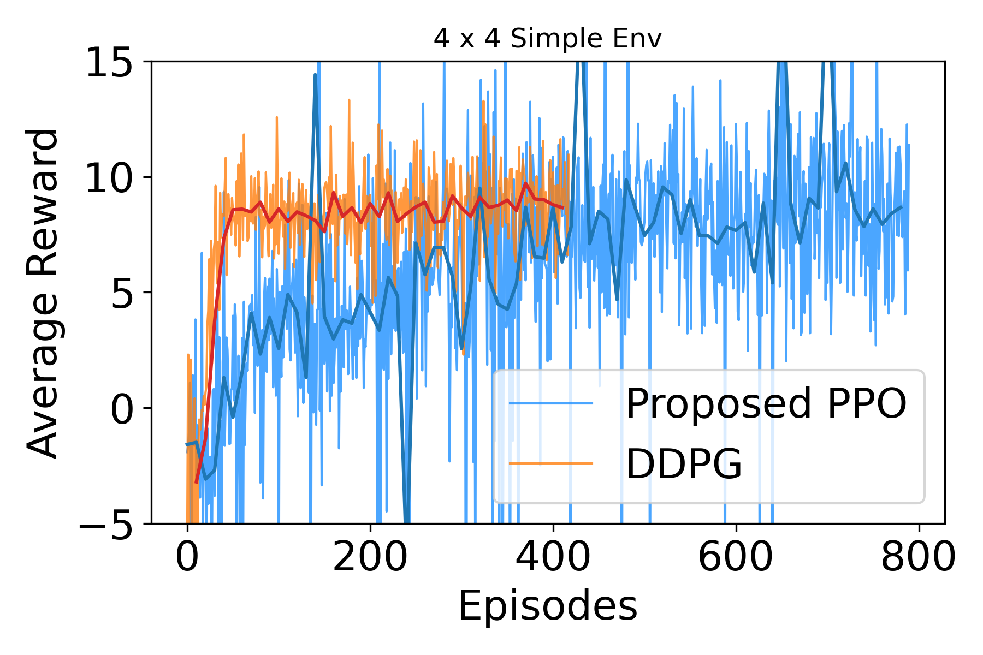
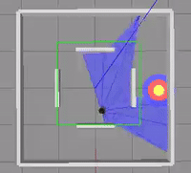
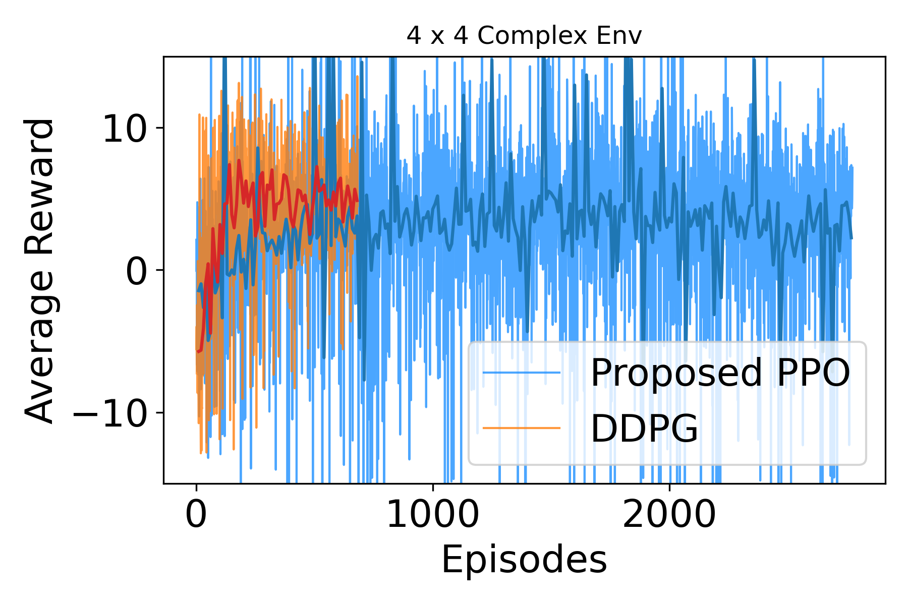
Performance

Slide 12
Future Work
Q1: The proposed PPO shows the slower convergence speed compared to DDPG
Q2: The Converged reward of the proposed PPO is similar or slightly worse than DDPG in 4 x 4 environments
A1: Increase learning rate and reduce neurons in Residual Block layers
A2: Adjust PPO's initial noise level in stochastic policy to enhance reward convergence.
Exploration vs. Exploitation trade-off plays a crucial role in final reward values.

Slide 13
References
Papers cited | How is the paper used (specifics) | Remarks (if any)
[1] H. Taheri and S. R. Hosseini, “Deep reinforcement learning with enhanced PPO for safe mobile robot navigation,” arXiv preprint arXiv:2405.16266, 2024 | We relied extensively on this paper across Sections I through V to develop the PPO agent for robot navigation.
[2] Z. Liu, Y. Zhai, J. Li, G. Wang, Y. Miao, and H. Wang, “Graph relational reinforcement learning for mobile robot navigation in large-scale crowded environments,” IEEE Transactions on Intelligent Transportation Systems, 2023. | We use this paper to introduce Graph Relational Reinforcement Learning (GRRL) for robot navigation in Section I.
[3] Z. Wang, Y. Wang, Z. Wang, H. Yan, Z. Xu, and Z. Wu, “Research on autonomous robots navigation based on reinforcement learning,” in 2024 3rd International Conference on Robotics, Artificial Intelligence and Intelligent Control (RAIIC). IEEE, 2024. | We use this paper to introduce Deep Q-Networks for robot navigation in Section I.

